Slide 1
CS 211 Computer Architecture Lecture 3: Moore’s Law and Power Constraints
Ravi Mittal
ravi.mittal@iitgoa.ac.in
Indian Institute of Technology, Goa

Slide 2
Thought of the day..
Eighty percent of people who fail at work do so for one reason: they don’t relate well to other people
Action: Look at your own behavior and thoughts

Slide 3
In the class we will study
Moore’s law and its implications
Heat Constraints
Power Constraints
Towards Multicore Architecture

Slide 4
Reading
Chapter 1 - Computer Abstractions and Technology - Patterson and Hennessy
Chapter 9 - Current Limitations and future challenges, Book, Microprocessor Architecture, Jean-Loup Baer

Slide 5
The World is flat now..
Sitting in Gotegaon in MP, you can access any document or artifact – just as anyone does in Bay Area in Silicon Valley can do…
What has made this possible ….
Affordable Computing
Affordable Communication
Computer Technology advanced very fast – almost two times computing power – every 1.5 years --> for the same computing power, cost reduces by half every two years..
Tremendous improvements in Chip Technology
Communication advances lagged behind for the first 30 years.. Now trying to catch up
Fiber Optics, 4G-5G, The Internet

Slide 6
Moore’s Law

Slide 7
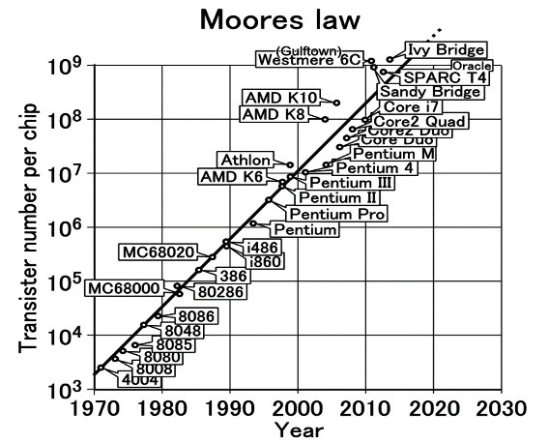
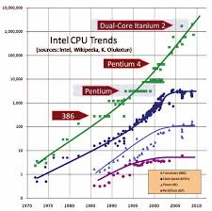
Moore’s Law
The number of transistors on a chip doubles about every 18-24 months
Gordon Moore, co-founder of Intel, 1965
True for 50+ years

Slide 8
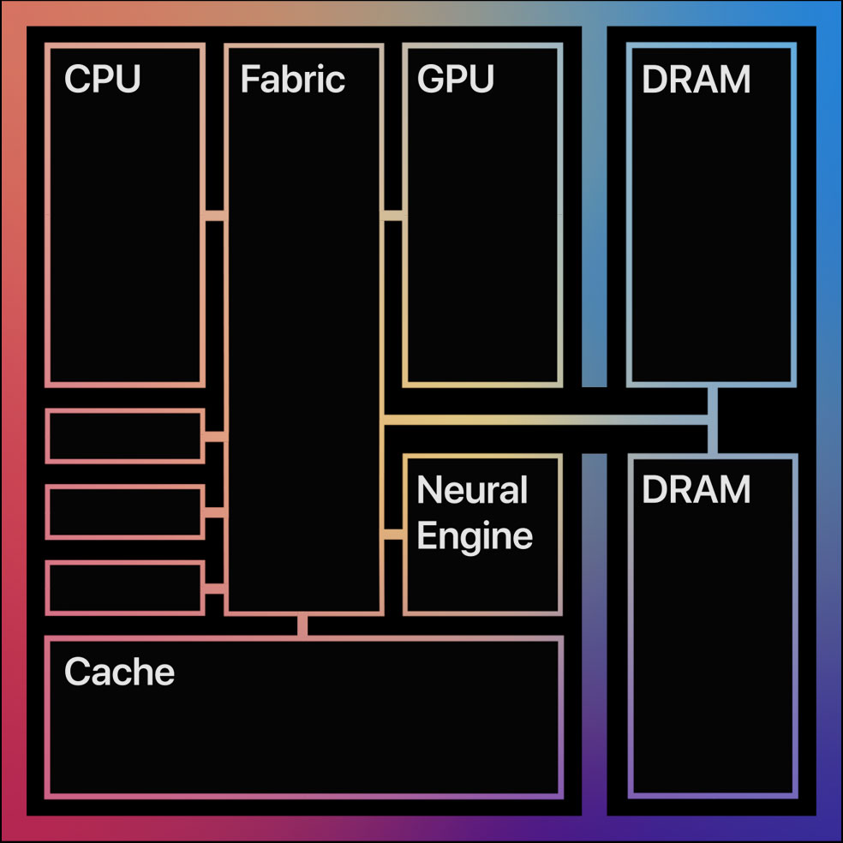
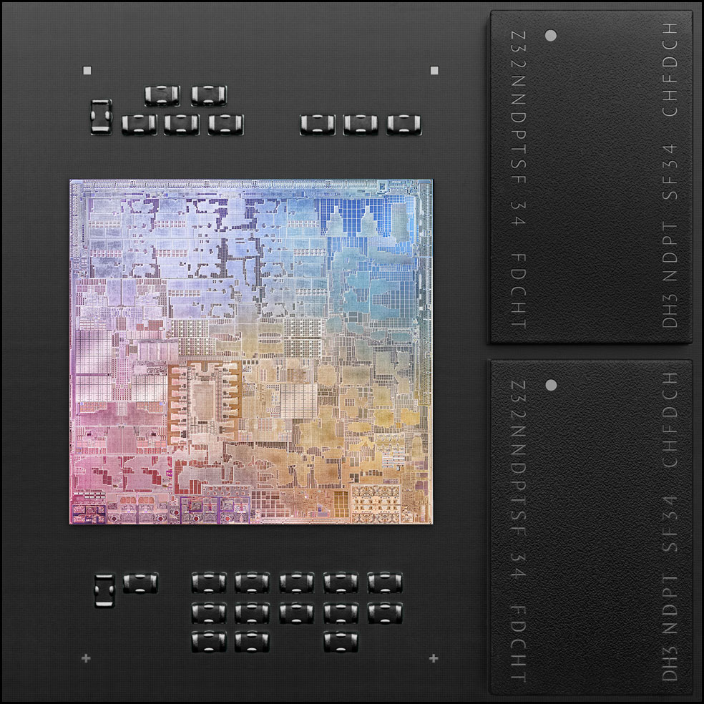
What makes Moore’s law possible?
Transistors are getting smaller in each generation
70% in each dimension compared to previous generation
Current transistor dimension: 5nm - 20nm
Recently released Apple’s M1 chip uses 5nm technology
16 Billion transistors

Slide 9
Interpretation
Transistor count is increasing per Moore’s law
Currently Microprocessor chips contain over 10 Billion transistors
Apple M1 (year 2020): 16 Billion Transistors : 5 nm wide
about 25 silicon atoms
Nvidia GA 100 Ampere (year 2020): 54 Billion transistors: 7 nm
Samsung DRAM eUFS (1 TB) (year 2020): 8Tb; 2048 Billion Transistors
Number of cores (processors) is increasing (why?)
The way to utilize increase in transistors –> use multiple cores

Slide 10
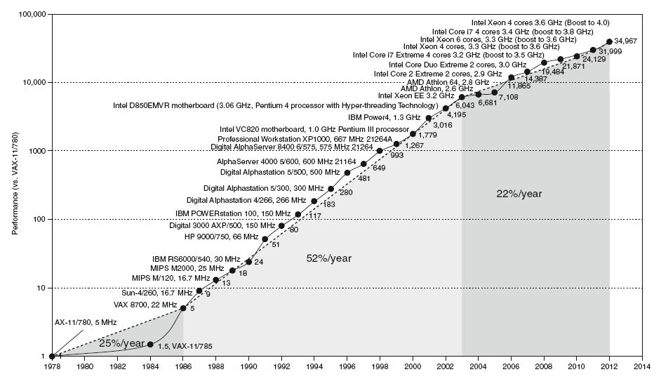
Uniprocessor Performance
Constrained by power, instruction-level parallelism, memory latency
Chart plots performance relative to the VAX 11/780

Slide 11
Moore’s law impact on Devices
Strong link between Device’s Capabilities and Moore’s law
Example: Digital Camera
Processing Speed
Memory Capacity
Power consumption
Sensors and number/size of pixels
The exponential improvements → Dramatic enhancement in impact of digital electronics in all segments → tremendous changes in our lives
Growth continued exponentially for nearly 50 years

Slide 12
Moore’s law – slowing down
After 2013, growth is slowing down
Transistor count is doubling every 3 years
April 2005: Gordon Moore stated that the law cannot be sustained indefinitely
Transistors would eventually reach the limits of miniaturization at atomic levels
Transistors have become very small and the gap between them very less (very narrow) → Electric current started leaking
→ less energy efficiency
→ risk of overheating
Processor clock speed has not changed in 15 years

Slide 13
A few facts
All exponential must end
Or they will eat the universe
From 1980 to 2010
Clock speed: 3500 x
Micro-architecture/Arch : 50x speedup

Slide 14
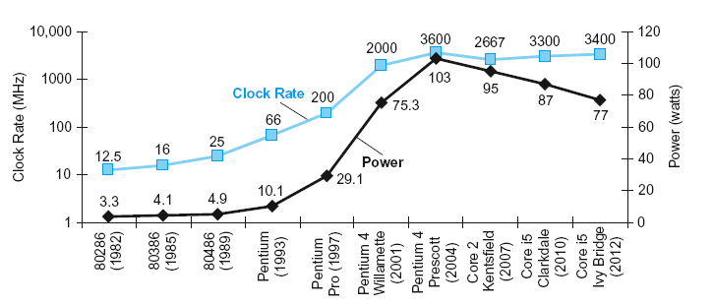
Power and Clock Rate - Trend
Increase in clock rate and power of eight generations of Intel microprocessors over 30 years
Grew together because they are correlated
Recent slowing - as run into the practical power limit for cooling
Chapter 1 — Computer Abstractions and Technology — Patterson and Hennessy

Slide 15
Faster Clocks, Power dissipation, Heat…
Note that clock rates are not increasing any more
Faster clocks – Faster execution of programs (in general)
Why can’t we continue to increase clock speed?
Power dissipation – yes. What else
Wire length – communication time limitation – within a clock cycle
Pipeline Depth – study later
Why is there any limitation on electric power?
Heat
Battery/power consumption
What is the relationship between heat and power?
Power is the rate at which the computer consumes electrical energy – includes heat

Slide 16
Faster Clocks, Power dissipation, Heat…
In a processor (say processor chip), what is the correlation between power dissipated and heat in different parts of the chip?
A lot of studies have been conducted
What is the need for less power consumption?
Heat management
Battery consumption / power consumption
Power management techniques and thermal techniques have a lot in common

Slide 17
Power, Multicore
Most of last 50 years, Moore’s Law ruled
Technology scaling allowed continual performance/energy improvements without changing software model
Increase in the number of transistors (as per Moore’s law) will see increase in number of cores (processors)
Haswell Xeon CPUs already offer up to 18 cores
Knights Landing Xeon Phis will be equipped with 72 cores
This will require massively parallel algorithms
For practical reasons of cooling, all mainstream computing hardware today is limited to about 250 to 300 Watts
Question: Why do we need multiple cores?

Slide 18
Trivia
Energy costs make up about ____ % of datacenter operating costs
10%
20%
30%
50%
A large size datacenter has approximately ____ number of servers.
1000
10000
100000
1000000

Slide 19
Trivia
Energy costs make up about ____ % of datacenter operating costs
10%
20%
30%
50%
A large size datacenter has approximately ____ number of servers.
1000
10000
100000
1000000

Slide 20
Power constraints

Slide 21
Thermal Design Power (TDP)
Thermal Design Power, in watts, and refers to the power consumption under the maximum theoretical load
The TDP is the maximum power that one should be designing the system for

Slide 22
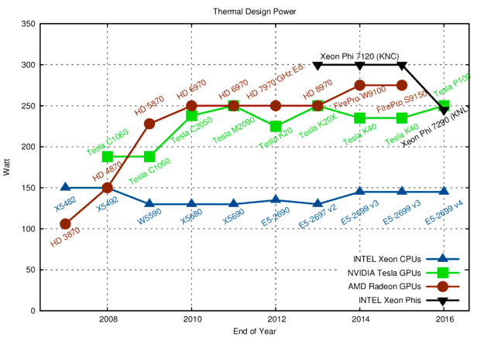
Thermal Design Power
https://www.karlrupp.net/2013/06/cpu-gpu-and-mic-hardware-characteristics-over-time/
Notes:
TDP stands for Thermal Design Power, in watts, and refers to the power consumption under the maximum theoretical load. Power consumption is less than TDP under lower loads. The TDP is the maximum power that one should be designing the system for.

Slide 23
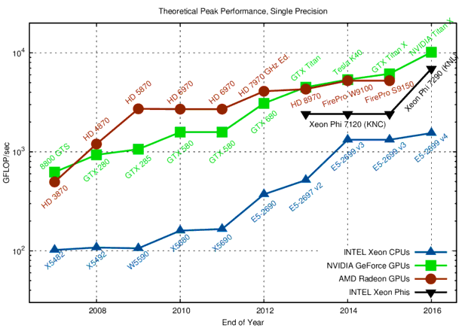
Raw Compute Performance
https://www.karlrupp.net/2013/06/cpu-gpu-and-mic-hardware-characteristics-over-time/
Notes:
Accelerators and co-processors are great for providing high performance in terms of floating point operations (FLOP) per second.
The comparison of theoretical peak performances for single precision arithmetic shows a five- to fifteen-fold margin when comparing high-end CPUs with high-end GPUs. This margin largest around 2009, when general purpose computing on GPUs (GPGPU) took off. The introduction of Xeon CPUs based on the Sandy Bridge architecture (with support for AVX) in 2012 and the dual-issue floating point units introduced with Haswell in 2014 reduced the gap between CPUs and GPUs.

Slide 24
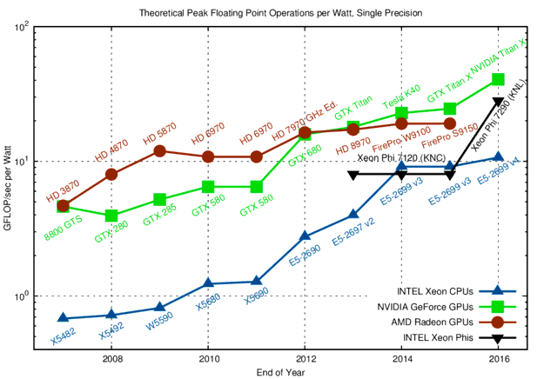
Raw Compute Power per Watt
https://www.karlrupp.net/2013/06/cpu-gpu-and-mic-hardware-characteristics-over-time/

Slide 25
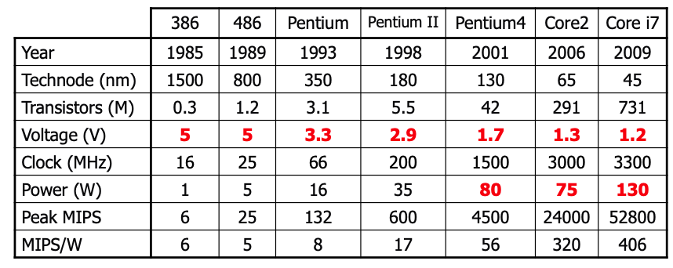
Trend in Power
Supply voltage is decreasing over time; 5 V → 1 V
“Voltage scaling” is reaching it’s limit
Clock frequency – not much increase

Slide 26
Moore’s law - Summary
Transistor density on a chip has been doubling every 18-24 months.
Moore’s law has been applicable for the last 5 decades or so.
Moore’s law is slowing down since 2014 or so
Now transistor density is doubling in approximately 3 years
Technology has reached 5 nm thickness
Clock speeds are not increasing for the last 5-6 years
Higher clock speed → More power consumption
Higher clock speed → less time to do work per clock cycle
Voltage scaling limits have already reached 1V
In the next class we will study details of Power consumption issues

Slide 27
Backup

Slide 28
Power vs Energy
Energy tells us the true “cost” of performing a fixed task
Power (energy/time) poses constraints; can only work fast
enough to max out the power delivery or cooling solution
If processor A consumes 1.2x the power of processor B, but finishes the task in 30% less time, its relative energy is 1.2 X 0.7 = 0.84;
Processor A is better, provided that 1.2x power can be supported by the system

Slide 29
Problem 1
For a processor running at 100% utilization at 100 W,
20% of the power is attributed to leakage. What is the
total power dissipation when the processor is running at
50% utilization?
Total power = dynamic power + leakage power
= 80W x 50% + 20W
= 60W
Solve for 0% utilization; the system consumes 20W.
This is the basis for “server consolidation” in datacenters
(move processes so you have a few highly utilized servers).

Slide 30
Problem 2
If processor A consumes 1.4x the power of processor B,
but finishes the task in 20% less time, which processor
would you pick:
(a) if you were constrained by power delivery constraints?
Proc-B
(b) if you were trying to minimize energy per operation?
Proc-A is 1.4x0.8 = 1.12 times the energy of Proc-B
(c) if you were trying to minimize response times?
Proc-A is faster, but we could scale up the frequency
(and power) of Proc-B and match Proc-A’s response
time (while still doing better in terms of power and
energy)

Slide 31
Problem 2
If processor A consumes 1.4x the power of processor B,
but finishes the task in 20% less time, which processor
would you pick:
(a) if you were constrained by power delivery constraints?
(b) if you were trying to minimize energy per operation?
(c) if you were trying to minimize response times?

Slide 32
Reducing Power and Energy
Can gate off transistors that are inactive (reduces leakage)
DFS: Dynamic frequency scaling -- only reduces frequency and dynamic power
DVFS: Dynamic voltage and frequency scaling – can reduce voltage and frequency by (say) 10%; can slow a program by (say) 8%, but reduce dynamic power by 27%, reduce total power by (say) 23%, reduce total energy by 17%

Slide 33
Problem 3
Processor-A at 3 GHz consumes 80 W of dynamic power
and 20 W of static power. It completes a program in 20
seconds.
What is the energy consumption if I scale frequency down
by 20%?
What is the energy consumption if I scale frequency and
voltage down by 20%?

Slide 34
Moore’s law: Enablement of new era
People carry smart phone in their pocket
More powerful than the biggest computer made in 1995
Slender laptops, Streaming video, social media, search, the cloud, smart devices, and the Internet, computers in automobiles, WWW, Human Genome project, social engineering, Online entertainment

Slide 35
Reducing Static Power
P_{static} ~ N*V*e^{–Vt}
Reduce the number of transistors (N)
Use fewer transistors/gate
Disable transistors
Power gating disable power to unused parts of chip
Power down units (or entire core) not being used
Long latency to power up
Reduce Voltage (V)
Linear reduction in static energy consumption
But also slows down transistors (transistor speed is ~ V)
Dual V_{t} – Use mix of high and low V_{t} transistors
Use slow low leak transistors in SRAM
Low-leakage transistors

